Slide 1
Machine Learning Methods
Maximum entropy
Maxent is an example
Boosting:
Boosted Regression Trees
Neural Networks

Slide 2
Machine Learning
Branch of artificial intelligence
Supervised learning:
Algorithms that “learn” from data
Deals with representation and generalization
Generalization:
Can operate on data that has not been seen before
Rigor provided by computational learning theory

Slide 3
Issues
Methods we’ll examine:
Work just like linear regression but can produce much more complex models
Fitting algorithms are “hidden”
Parameters harder to access and examine
Produce better “model fits”
Tend to “over fit”

Slide 4
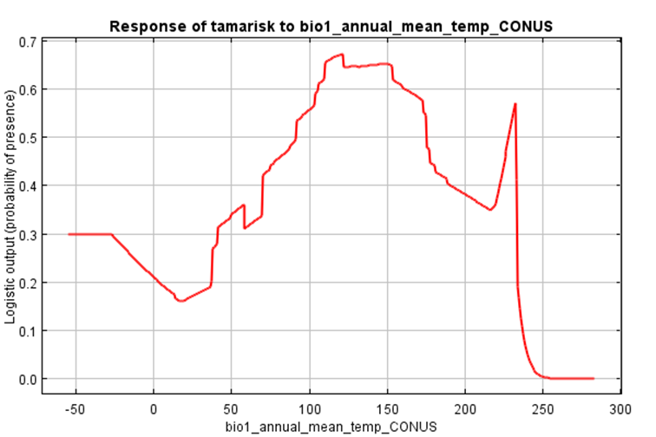
Tamarisk: Temp and Precip
162 parameters

Slide 5
Boosting
Using “weak learners” together to make a “stronger learner”.
Gradient boosting
For regression problems
Uses an “ensemble” of weak prediction models
Gradient tree boosting
Uses many tiny regression trees to make more complex models

Slide 6
Boosted Regression Trees
The “weak” learners are individual, binary trees of three nodes
There can be thousands of trees!
The trees are hidden within the model
Now we can really over fit our model!

Slide 7
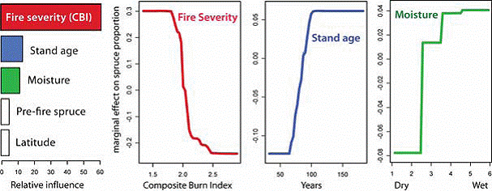
Boosted Regression Trees
Relative dominance black-spruce vs. deciduous trees in post-fire Alaska
http://www.lter.uaf.edu/bnz_disturbance.cfm

Slide 8
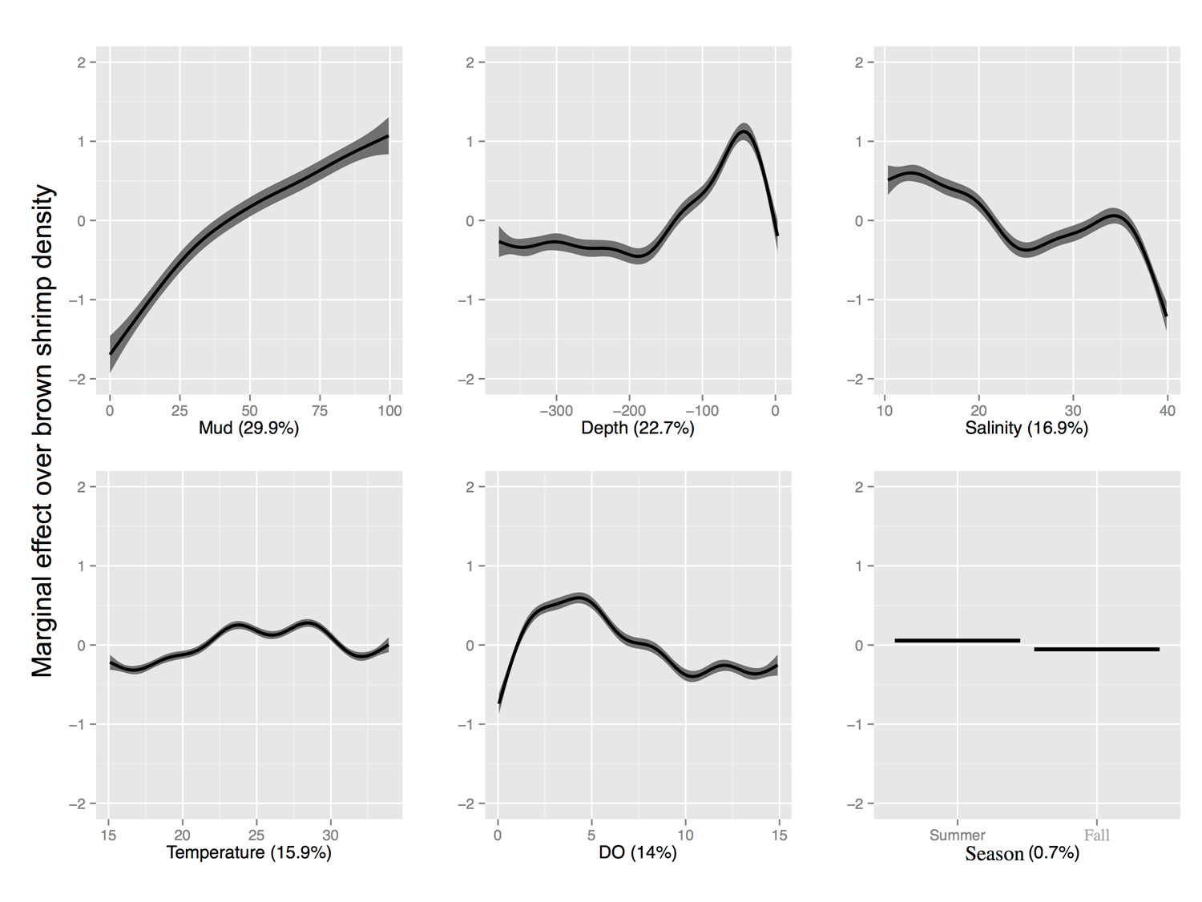
Brown Shrimp BRT Model

Slide 9
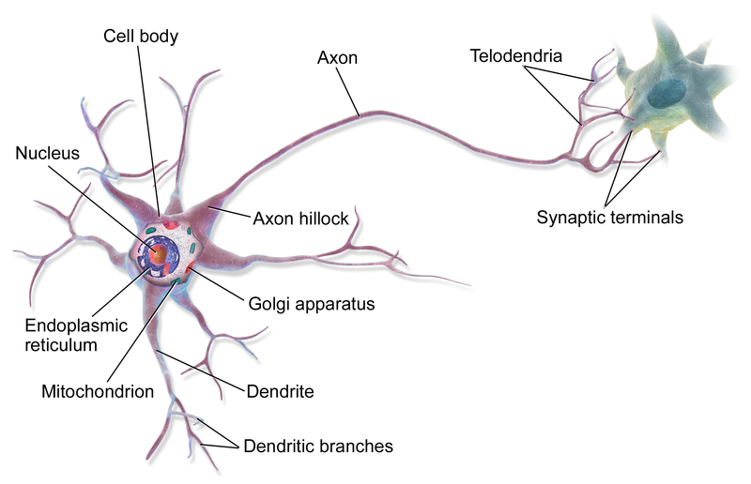
A Neuron
Wikipedia

Slide 10
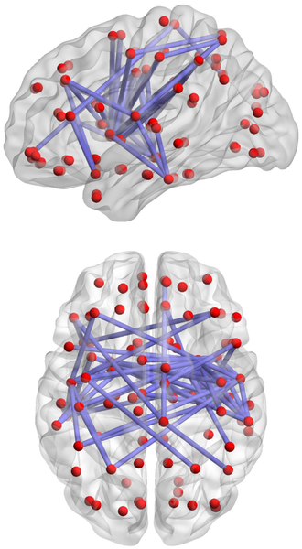
Neural Network
Basically:
Neurons “sum” charge from other neurons
When charge goes over a threshold,
The neuron turns “on” and sends a signal to other neurons

Slide 11
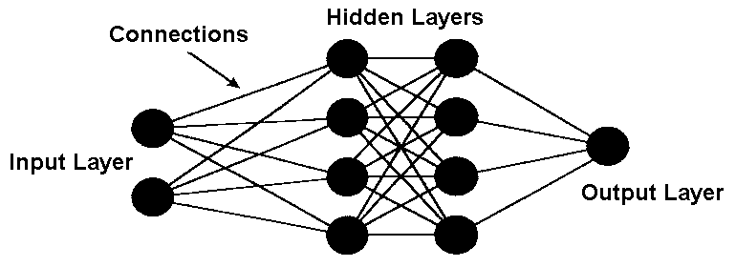
Artificial neural network
AIDA

Slide 12
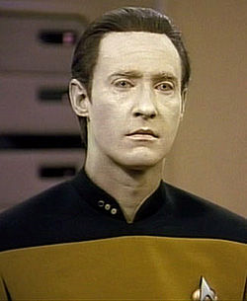
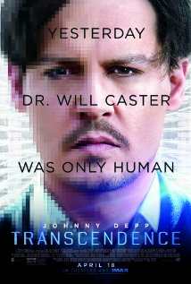
Artificial Neural Networks
Advantages:
Very flexible
Can model “fuzzy” problems
Successes in simple visual recognition, some expert systems.
Disadvantages:
Hidden model
Can be slow
Have not been able to solve a wide range of problems

Slide 13
Expert Systems
Attempt to capture “expertise”
Originally was part of the promise of neural networks
Now largely driven off very large databases
WebMD was one attempt
Ask Jeeves was another (ask.com)

